Slide 1



INSTITUTE : UIE
DEPARTMENT : CSE
Bachelor of Engineering (Computer Science & Engineering)
Disruptive Technologies-3
(23CSH-203)
Topic: Blockchain
DISCOVER . LEARN . EMPOWER
Notes:
1

Slide 2
Blockchain

Slide 3
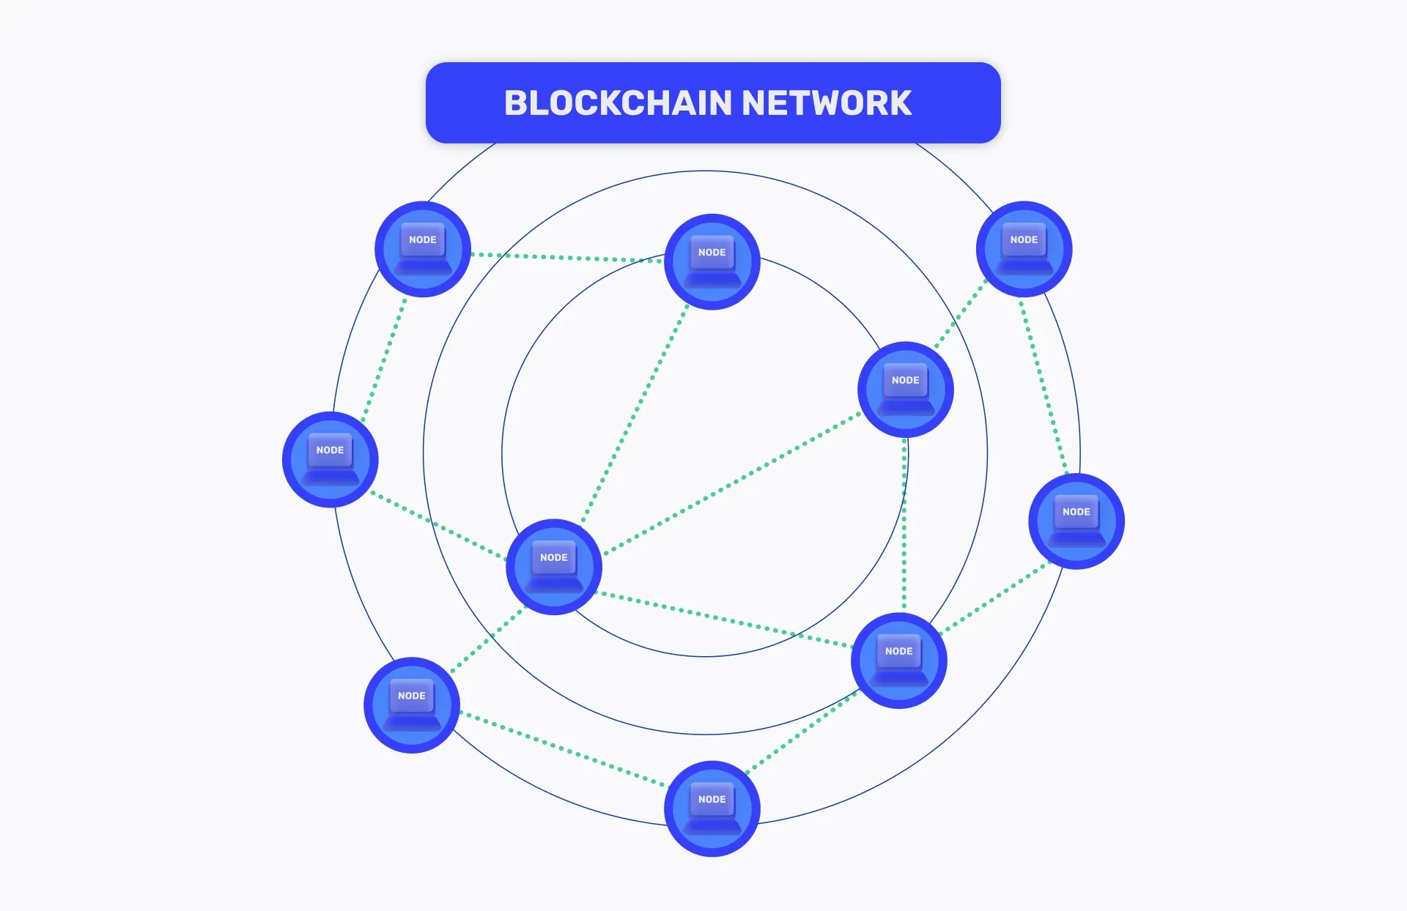
What is Blockchain Network?
A blockchain network is known as a distributed, decentralized, and immutable peer-to-peer digital ledger to record transactions and data from different computer nodes. Generally, Blockchains are created for specific purposes including users getting varied types of tasks or access.
The Blockchain, a ledger of records known as Blocks is connected using cryptography. Every block includes a cryptographic hash of the previous block, transaction data, and a timestamp. Blockchain also abolishes data supplication and increases security via data integrity.

Slide 4
Need for Different Types of Blockchain Networks
There are four main types of Blockchain networks- Public, Private, Hybrid, and Consortium. And here, the question arises why we need these different Blockchain types or networks.
The need for different Blockchain types arises because of diverse requirements and to address specific challenges. Look at the following reasons to know the need for diverse types of Blockchain-
Privacy and Security
Scalability
Smart Contract Capabilities
Cost & Efficiency
Consensus Mechanism
Regulatory Compliance
Interoperability
11

Slide 5
Need for Different Types of Blockchain Networks
1. Privacy and Security
Some specific businesses and industries go for Blockchain services to have augmented privacy and data confidentiality. If they go for a public Blockchain, it reveals all the transactional data to the public, hence they prefer permissioned or private blockchains to limit access & visibility to allowed participants only to ensure confidentiality.
2. Scalability
Top Blockchain development companies use different Blockchain networks as per their capability to manage the number of participants and transactions. Some Blockchain networks are created for high transaction output, making them appropriate for apps that need fast processing, while others also go for decentralization leading to lower scalability. In terms of scalability, some companies are seeking for blockchain staffing solutions.

Slide 6
Need for Different Types of Blockchain Networks
3. Smart Contract Capabilities
Intricate smart contracts are not supported by all types of Blockchains; hence businesses need to use different Blockchain in order to handle them. Different networks cater to different levels of programmability enabling professionals to select the most appropriate platform depending on their app requirements.
4. Cost & Efficiency
The network efficiency and cost of transaction fees may differ significantly based on different Blockchains. Some Blockchain applications may need low-cost transactions, on the other hand, others prioritize efficiency and speed over costs.
5. Consensus Mechanism
Varied Blockchain networks employ different consensus mechanisms such as Proof of Stake, Proof of Work, Delegated Proof of Stake, etc. Also, businesses’ choice of consensus mechanism is based on aspects like energy efficiency, security, block finality, and decentralization.

Slide 7
Need for Different Types of Blockchain Networks
6. Regulatory Compliance
There are various industries and use cases requiring adherence to particular regulatory requirements. In comparison to public Blockchains, permissioned or private Blockchains allow for more control over users and data shared by them aiding compliance with related laws and regulations.
7. Interoperability
There are several Blockchains and distributed ledgers available that have made interoperability vital. Hence, different networks are there to ensure smooth interconnection and secure data exchange allowing smooth data flow across different systems.

Slide 8
Different Types of Blockchain Networks?
There are multiple ways to create Blockchain solutions, but depending on the business use and requirements, it is essential to choose a suitable blockchain network. Every Blockchain is created specifically for a purpose and to address particular issues.
Check out the below different types of Blockchain networks including public, private, hybrid, and consortium-
Public Blockchain
Private Blockchain
Hybrid Blockchain
Consortium Blockchain

Slide 9
1. Public Blockchain
Among all types of Blockchains, Public blockchains are the most used types. These allow everyone to join the network and are fully decentralized. It has a transparent digital ledger that can be accessed by anyone without any restriction or permission.
When it comes to private vs public Blockchain, public blockchains facilitate users for open participation and equal merits to validate and authenticate transactions to the chain. Every user in the network keeps a copy of the entire Blockchain along with security and redundancy.
Public blockchains use consensus mechanisms such as Proof of Stake (PoS) or Proof of Work (PoW). In this, PoW depends on computational power for transaction validation, on the other hand, PoS uses the stake of users AKA cryptocurrency holdings.

Slide 10
Public Blockchain
Advantages:
Having no central authority makes it unaffected by censorship and a single point of failure.
High level of transparency as all transactions are visible publicly resulting in enhanced trust and accountability.
The vast network of nodes provides high-level security and a robust consensus mechanism.
Anyone is allowed to join the network leading to innovation and inclusivity.
Users are incentivized to sustain and validate the Blockchain fostering network sustainability.
Disadvantages:
Public blockchains may have high fees for transactions at the time of heavy network usage.
The PoW consensus mechanism used in some public Blockchains such as Bitcoin requires high computational power and leads to many environmental issues.
Due to the openness, public blockchains can conflict with regulatory requirements in some areas, making it hard to conform to local regulations.

Slide 11
2. Private Blockchain
Private blockchains only allow participants with authorized and validated information. This works as a distributed ledger technology operating in a restricted network, a selected group of participants, and with limited access.
In public vs private blockchains, public blockchains are open to anyone but private blockchains are permissioned reflecting the allowance to only pre-approved participants.
Private blockchains permit organizations to have more control over all the data and processes making them compatible with industry regulations and other policies.
Also, the consensus mechanism is faster and more efficient in comparison to the public blockchain as there are limited participants. It makes private blockchain suitable for enterprise-level apps with paramount privacy and speed.
Above all, private blockchains provide enhanced security as it is only accessible to limited members only leading to less risk of unauthorized access and possible risks.

Slide 12
Advantages:
It provides limited access to only trusted participants alleviating the risk of illegal entry and possible attacks.
Faster transactions and speed along with enhanced data confidentiality and privacy.
A private blockchain can be customized according to specific organizational requirements.
Fewer validators and nodes result in less operational costs in comparison to public blockchains.
Smaller network size results in more efficient consensus mechanisms.
Disadvantages:
Decreased level of decentralization due to a controlled number of participants.
The selected group of validators or authorized nodes can have a single point of failure if any of them gets malfunctions or compromises.
Creating and maintaining a private blockchain can lead to enhanced Blockchain app development costs due to significant investment in administration and infrastructure.

Slide 13
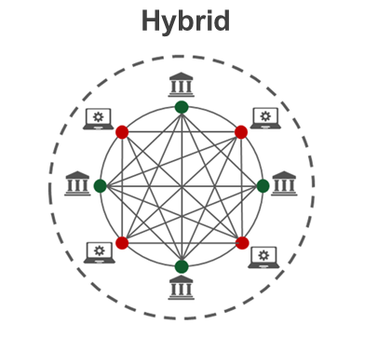
3. Hybrid Blockchain

Slide 14
Hybrid Blockchain
Hybrid Blockchain is among the types of Blockchain networks that is an amalgamation of public and private Blockchain networks. It comprises the best of both networks enabling decentralization, transparency, and immutability similar to public Blockchain. The Hybrid Blockchain network also has some elements of private blockchains such as faster transaction processing and enhanced privacy.
Hybrid Blockchains store confidential transactions and sensitive data on a private network that is only available to authorized participants including consortiums or businesses. On the other hand, less sensitive data will be stored on the public chain leading to inclusivity and openness.
A Hybrid Blockchain network is specifically beneficial for industries such as healthcare, finance, and supply chain management requiring regulatory compliance and secure data handling.

Slide 15
Advantages:
The blend of public and private networks enables higher scalability by adapting a larger number of transactions.
The hybrid approach facilitates organizations to tailor their blockchain infrastructure to align their specific use cases providing more flexibility than a regular solution.
Employing a combination of public and private networks would be more cost-efficient than adopting an entire private blockchain network.
This network is helpful to develop trust between participants as it creates a balance between data confidentiality and openness.
Private chains offer quicker transaction processing in comparison to entire public blockchains to enhance system performance overall.
Disadvantages:
A Hybrid Blockchain network adds complexity to the entire architecture and needs appropriate integration & synchronization between private and public components.
The Hybrid model can have potential attack vectors as both private and public chains require to be secured properly.
The combination of private and public elements may raise governing concerns, particularly about data privacy and compliance in related industries.

Slide 16
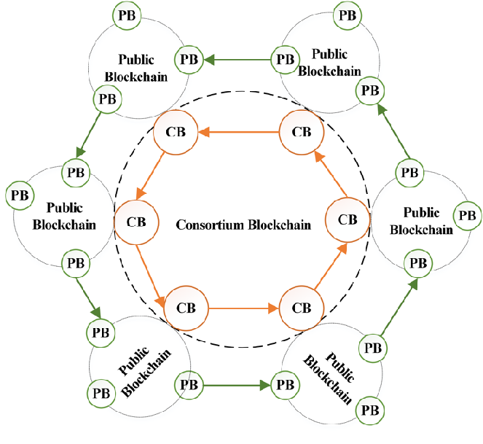
4. Consortium Blockchain

Slide 17
Consortium Blockchain
Consortium Blockchain network works as a distributed ledger technology comprising the benefits of both private and public blockchain networks. In this network, a group of trusted and pre-chosen participants including organizations, companies, or government entities create a network to maintain and authorize the blockchain collaboratively.
Unlike public Blockchains that are open to everyone and private blockchains regulated by a single entity, the Consortium Blockchain network provides a middle way. It allows consortium members to share confidential data securely while continuing transparency and decentralization.
The governance model of consortium blockchain includes a consensus protocol agreed upon by the active individuals to enable validated transactions that are added to the Blockchain ledger transparently.
It leads to enhanced trust and less risk of malicious activities. Overall, consortium blockchains maintain a balance between the decentralization advantages of public blockchains and the controlled access needed for enterprise use cases.

Slide 18
Advantages:
Restricted access to trusted users guarantees the security and confidentiality of sensitive data while lessening the risk of unauthorized access or attacks.
The consortium has a smaller group of validators; hence its consensus mechanism can be faster and more efficient leading to better scalability.
Less need for intricate PoW (proof of work) or consensus algorithms outcomes in transaction fees and lower energy consumption.
This network facilitates smooth collaborations and data distribution between organizations resulting in managed workflows and enhanced interoperability.
The Consortium Blockchain network can be customized to align with the specific requirements of participants which makes it simple to execute industry-specific use cases.
Disadvantages:
Decisions related to consensus mechanisms, updates, and network rules need an agreement among consortium members resulting in possible governance clashes and interruptions in executing changes.
Though consortium blockchains provide more privacy in comparison to public blockchains that can lead to less transparency for external stakeholders and auditors. It makes data accuracy verification harder on the blockchain.
When the Consortium is controlled by strong entities, there is always a risk of collusion in negotiating the justice and neutrality of the network.

Slide 19
Types of Blockchain Protocols
Below are some of the types of blockchain protocols:
1. Hyperledger: Hyperledger is an open-source framework that is developed by Linux. It helps the enterprises to provide blockchain solutions, and how to create a secured blockchain protocol. It was developed in the year 2015. It enables international business transactions. It supports Python and there are many libraries that help in software development. The main aim is to provide universal guidelines for Blockchain implementation.
Advantages:
It provides enhanced services because of the tools and presence of a large number of libraries.
It is open-source hence anyone can contribute.
It helps in international transactions.
Disadvantages:
There is a lack of use cases as well as skilled programmers.
It is not a network fault-tolerant.

Slide 20
Types of Blockchain Protocols
2. Quorum: Quorum is another enterprise blockchain protocol that aims to address the problems related to finance. It is open source project associated with Ethereum. It was developed by JP Morgan. It can change how financial enterprises function and implement blockchain. It is open-source and nowadays has become one of the best enterprise blockchain frameworks.
Advantages:
It has the ability to solve any financial query
It is an open-source framework
It provides better performance and provides an enhanced experience of transaction
Disadvantages:
Lack of scalability
Lack of security and privacy

Slide 21
Blockchain Protocols
3. Corda: Corda is an enterprise protocol. It is handled by the R3 banking consortium. This protocol is useful in the field of banking and financial organizations. It utilizes consensus algorithms to maintain transparency and security. It is also an open-source framework. It allows for the building of interoperable blockchain networks with strict privacy.
Advantages:
It provides enhanced security.
It is stable and scalable
Disadvantages:
It is not very flexible as only parties involved in the transaction can take part in the decision.

Slide 22
Blockchain Protocols
4. Enterprise Ethereum: Ethereum is one of the public blockchain suite protocols. It defines the platform for decentralized applications. It is the blockchain of choice for developers and enterprises, who are creating technology based upon it to change the way many industries operate. However, for private permissioned networks, enterprise Ethereum is used. It is mostly used for privacy, scalability, and improved performance
Advantages:
It is an enhanced version of Ethereum and hence supports more privacy.
It is scalable.
Disadvantages:
It is volatile and has high transaction fees.
It is prone to online hacking.

Slide 23
Blockchain Protocols
5. Multichain: Multichain is an open-source and was established for private blockchain networks. It was developed to help profit-making corporations. It allows to set up of a private blockchain network. It is a private company that offers API for Blockchain development. It is a cross-chain router protocol. It allows users to swap tokens between different blockchains using a bridge.
Advantages:
It helps to establish private blockchains that can be used by certain organizations.
Multichain allows customizing rules for tokens, transaction control, etc.
Disadvantages:
It does not support smart contracts.

Slide 24
References
Text books:
Blockchain Technology: Algorithms and Applications Paperback – 6 December 2023 by Asharaf S.; (Author), Sivadas Neelima (Author), Adarsh S. (Author), Franklin John (Author)
Blockchain Basics: A Non-Technical Introduction in 25 Steps
Book by Daniel Drescher
Websites:
https://ntiprit.gov.in/pdf/blockchainanddistributed/Blockchain_Introduction_KR.pdf
https://bitcoin.org/bitcoin.pdf

Slide 25
THANK YOU

